Slide 1
COVID-19 Stringency & Economic Impact Analysis
Data Analytics & Machine Learning (2023S MIS 637-WS)
Uday, Hema, Nikhil, Prudhvi

Slide 2
Introduction
The COVID-19 pandemic has affected countries differently, leading to varied response measures globally.
Economic and human development indicators may influence these variations.
This presentation explores these relationships and the predictability of a country's response stringency.

Slide 3
Background
COVID-19, a global pandemic, has drastically impacted economies and societies worldwide.
Countries have enacted different measures to control the spread, measured as 'Stringency Index'.
It's hypothesized that a country's economic and development status may influence these measures.

Slide 4
Objective
Investigate if GDP per capita and Human Development Index can predict the stringency of a country's COVID-19 measures.
Utilize data science techniques to analyze, model, and visualize these relationships.
Derive insights that could help in understanding global response patterns.

Slide 5
Data Source
Data was sourced from Kaggle and includes various indicators for different countries.
Variables included Country, Date, Total Cases, Total Deaths, Stringency Index, GDP per Capita, Human Development Index, etc.
Dataset has been regularly updated reflecting the ongoing nature of the pandemic.

Slide 6
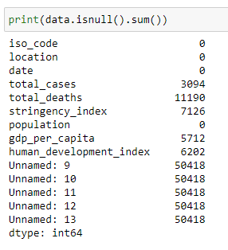
Data Cleaning
Data preprocessing involved handling missing values, removing unnecessary columns, and converting data types.
Certain columns with significant missing data were dropped.
Data types were converted for appropriate analysis.
Final dataset included cleaned and processed variables for further analysis.

Slide 7
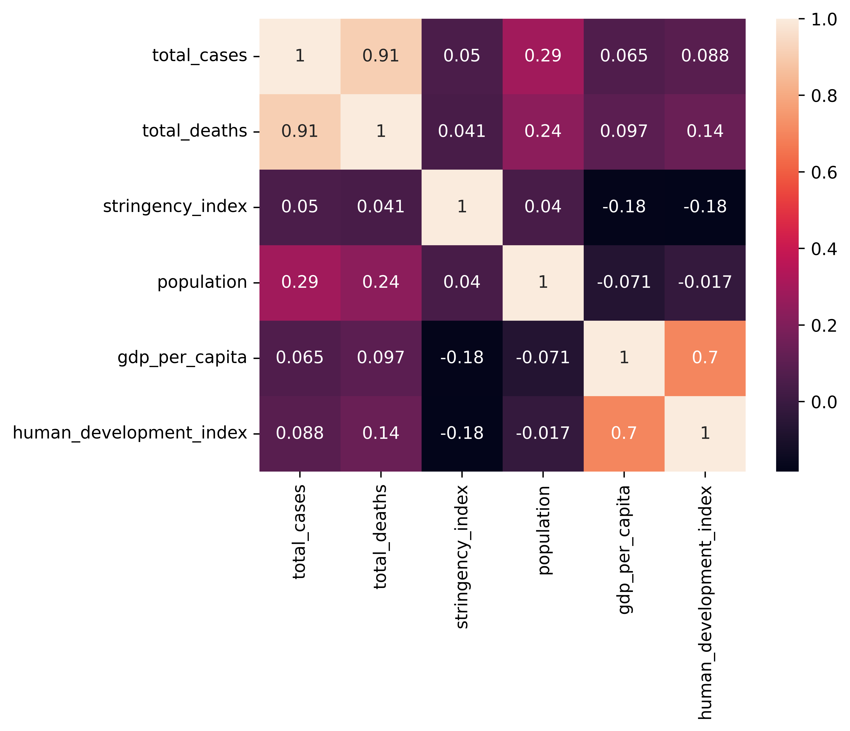
Exploratory Data Analysis
Initial data exploration involved generating summary statistics for different variables.
Measures of central tendency and dispersion provided insights into the data distribution.
No major data anomalies were found in the summary statistics.

Slide 8
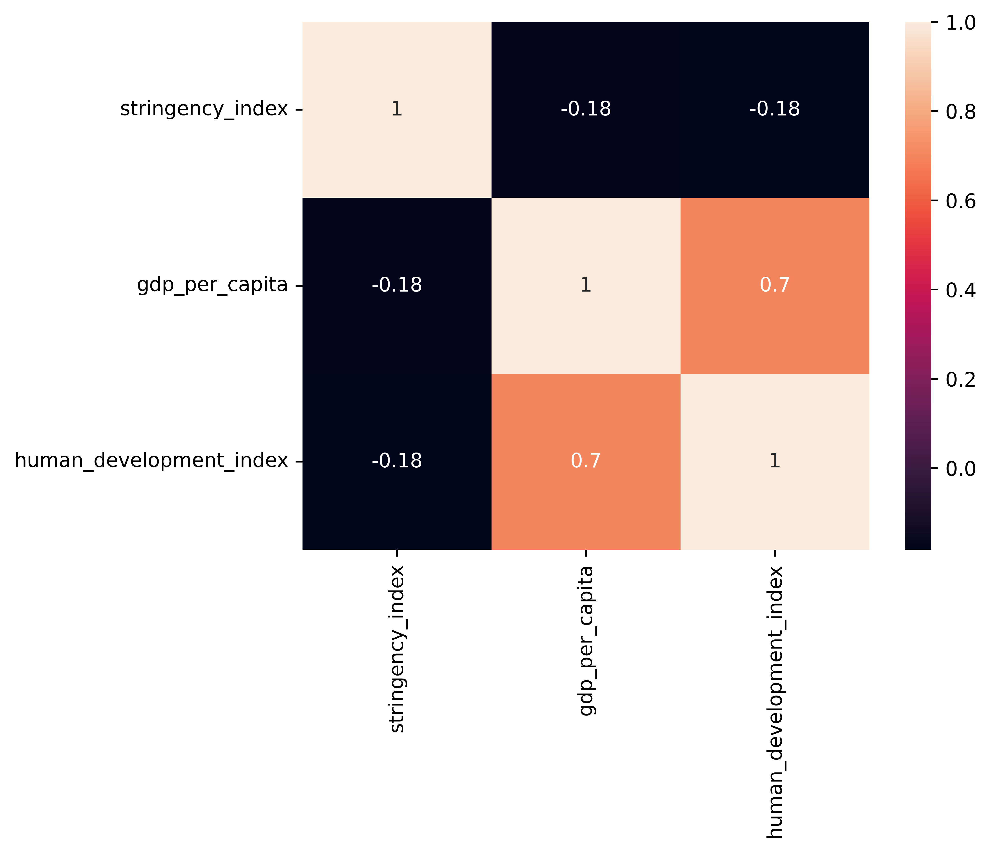
Correlation analysis was performed to identify relationships between variables.
A heatmap was generated to visualize these correlations.
GDP per capita and Human Development Index showed significant correlation with the Stringency Index.

Slide 9
Model Selection
Based on the exploratory analysis, OLS Regression and Random Forest models were selected.
OLS Regression was used for its interpretability and Random Forest for its ability to model complex relationships.
Both models were used to predict the Stringency Index based on GDP per capita and Human Development Index.

Slide 10
Model Training
Data was split into training and test sets to evaluate model performance.
Models were trained on the training data and then used to make predictions on the test data.
Training process involved tuning the model parameters to minimize prediction error.

Slide 11
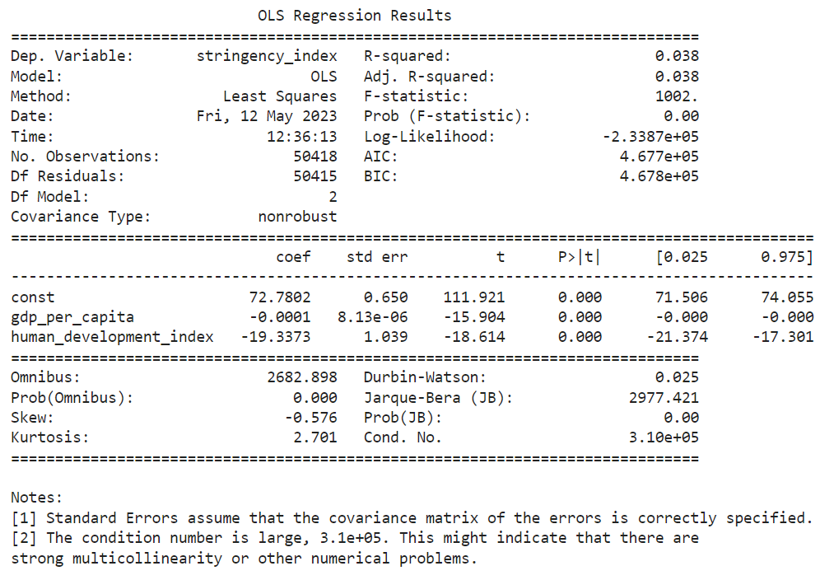
Model Results (OLS Regression)
OLS Regression model showed that both GDP per capita and Human Development Index are statistically significant predictors of the stringency index.
These variables only account for a small portion of its variation, suggesting other significant factors.
The statistical significance of the variables provides evidence for their influence on the Stringency Index.

Slide 12
Model Results (Random Forest)
The Random Forest model showed an average error of around 21.07 units (RMSE), indicating a reasonable fit to the data.
The model suggested that the relationship between the predictors and the Stringency Index may be non-linear.
The lower importance of GDP per Capita compared to the Human Development Index suggests the latter might be a better indicator for Stringency Index.

Slide 13
Model Evaluation
The performance of the two models was compared using their respective metrics.
While both models showed significance of the predictors, the Random Forest model suggested a more complex relationship.
The relatively higher error in the Random Forest model might be due to overfitting or need for more predictors.

Slide 14
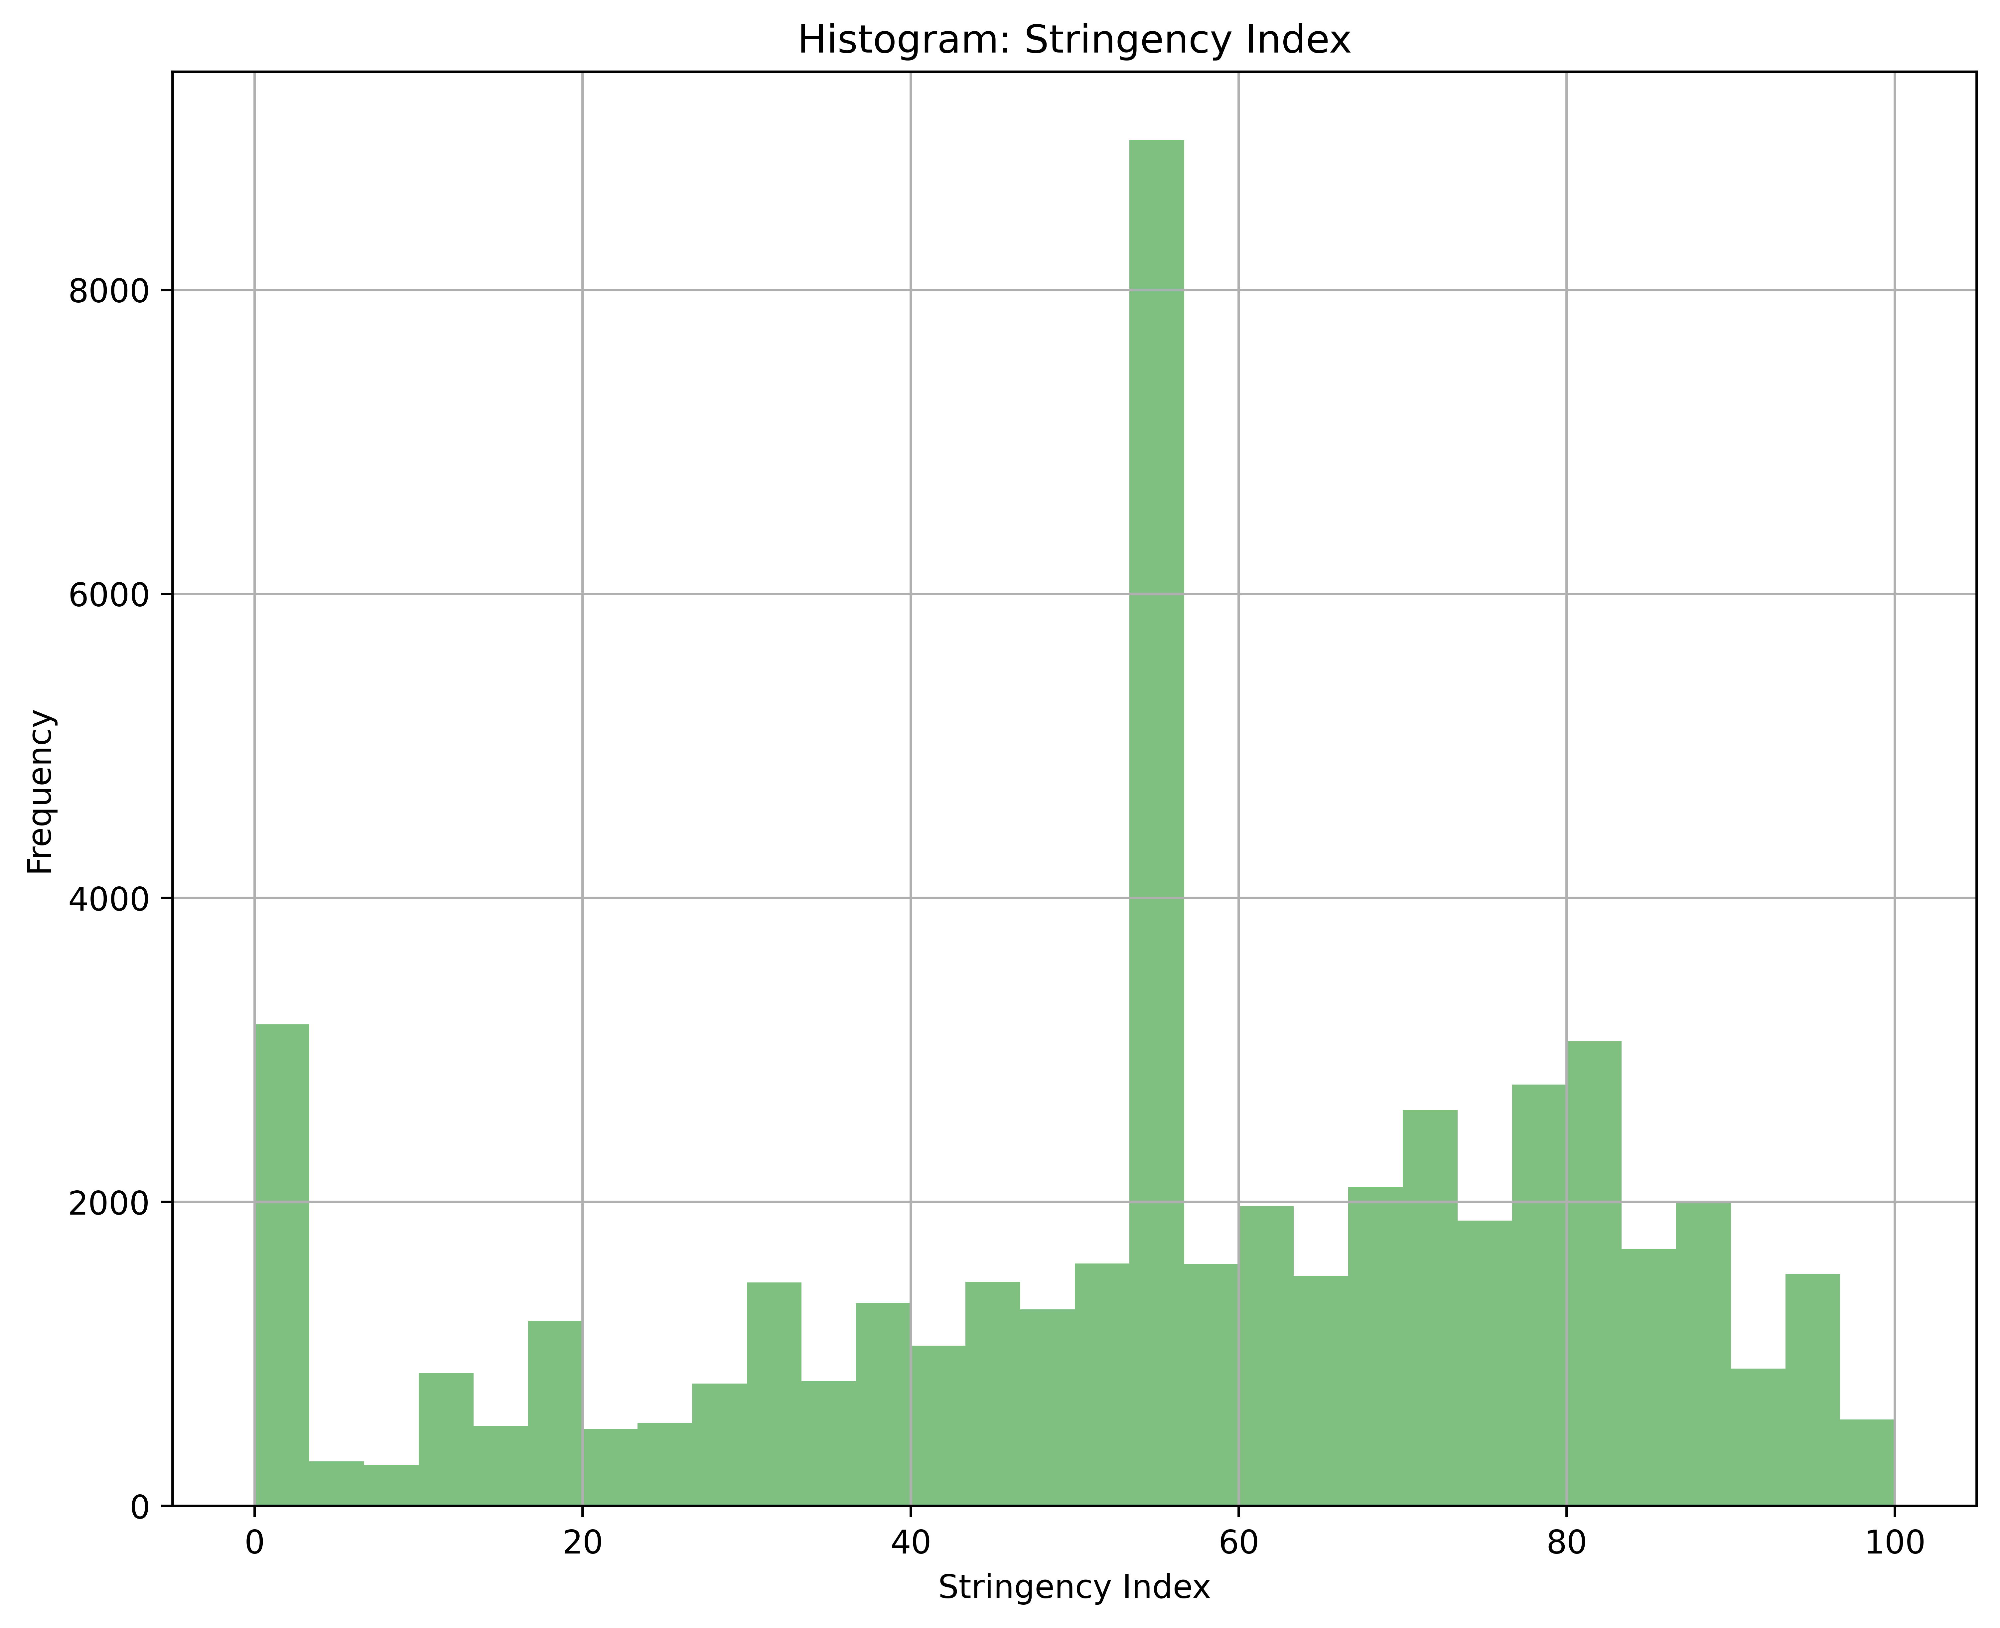
Implications of Results
The results suggest that GDP per capita and Human Development Index play a role in determining a country's COVID-19 response measures.
While the influence of these factors is statistically significant, it's clear other factors not included in this analysis are at play.
Understanding these relationships could inform policy decisions and strategies for managing pandemics.

Slide 15
Conclusion
This analysis provides initial insights into the relationship between economic and development factors and COVID-19 response measures.
The findings highlight the complexity of pandemic response strategies and the need for a holistic view when making policy decisions.
Further research in this direction could be instrumental in shaping effective responses to future global health crises.

